Slide 1
Pls 2000 power & politics
BEYOND NORMAL POLITICS:
Violent Non-State Actors, Terrorism and Insurgency

Slide 2
BEYOND NORMAL POLITICS:
Violent Non-State Actors, Terrorism and Insurgency
DEFINING TERRORISM
BEYOND NORMAL POLITICS: INSURGENCY, TERRORISM & GUERRILLA WAR
Terms To Know
In-group Perpetrator
Terrorism
Domestic Terrorism
Guerrilla warfare
Insurgency
VNSA

Slide 3
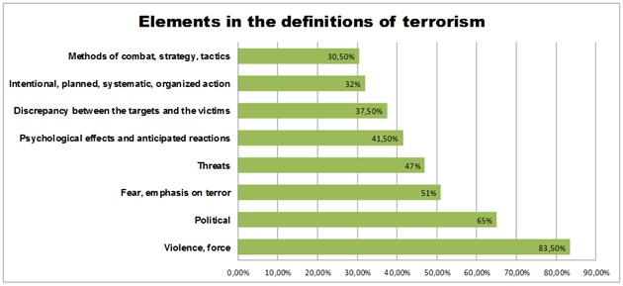
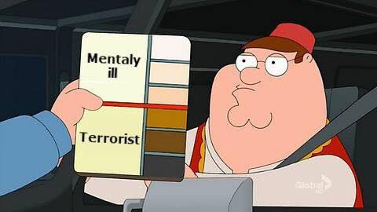
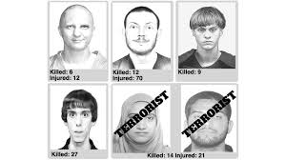
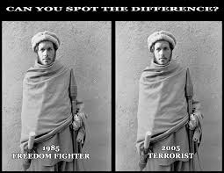
I. THE POLITICS OF DEFINING TERRORISM
Definition: Scientific or Political?
Terrorists v. Freedom Fighters
“All bona fide liberation movements are decried as terrorists by regimes against which the struggles are directed”
“the terrorist of yesterday is the hero of today”
In-group perpetrators: A bias in seeing those of your identity “in-group” in favorable terms – ie. those who do violence as patriot or freedom fighter – or as individually to blame (e.g. mentally ill) out of a “desire to distance your group from nasty behavior, to protect your cherished identity”
Mental illness: if people are not in control of their faculties, they—and the group you both belong to—bear less culpability for their actions”
If someone from a different group commits the same action, observer is more likely to attribute violence to terrorism.
https://www.middleeasteye.net/news/egypt-accused-using-terrorism-lists-political-tool-opposition

Slide 4
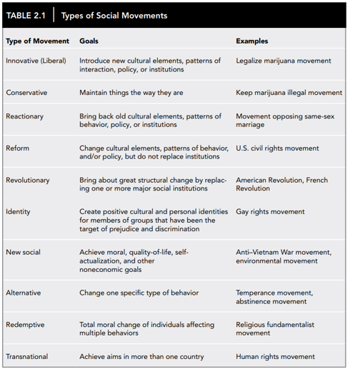
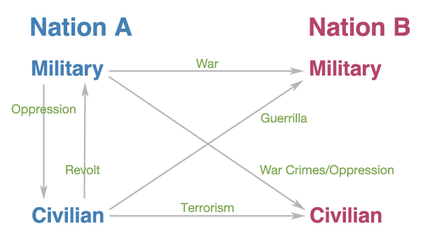
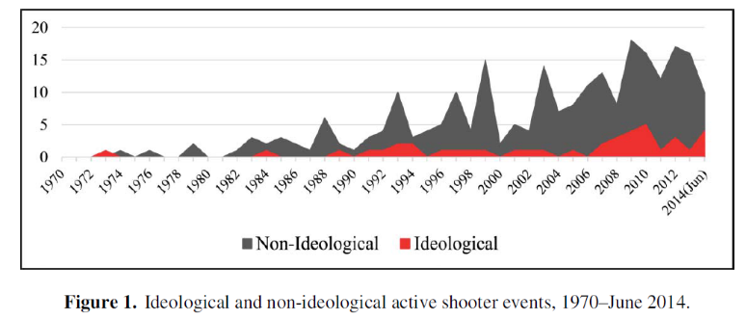
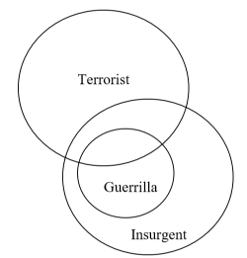
iI. BEYOND NORMAL POLITICS: Insurgency, TERRORISM & guerrilla war
VNSAs: Individuals or Societal groups that resort to violence to meet goals
Criminal Organizations & Gangs
Warlords
Militias & Paramilitary Forces
Mass Shooters: Political and Not
Political Violence:
Insurgency: “an organized resistance movement that uses subversion, sabotage, and armed conflict to achieve aims.
Guerrilla War: the overt military aspect of insurgencies; the political use of force against military targets to overthrow government, expel occupation, or achieve independence
Terrorism: “premeditated, politically motivated violence perpetrated against non-combatant targets by subnational groups or clandestine agents” (DoS)
Domestic Terrorism (FBI/DHS): activities within the territorial jurisdiction of the US involving acts dangerous to human life that are a violation of the criminal laws of the US, appearing to be intended to intimidate or coerce a civilian population and influence the conduct or policy of government by intimidation or coercion
https://www.fbi.gov/file-repository/fbi-dhs-domestic-terrorism-definitions-terminology-methodology.pdf/view

Slide 5
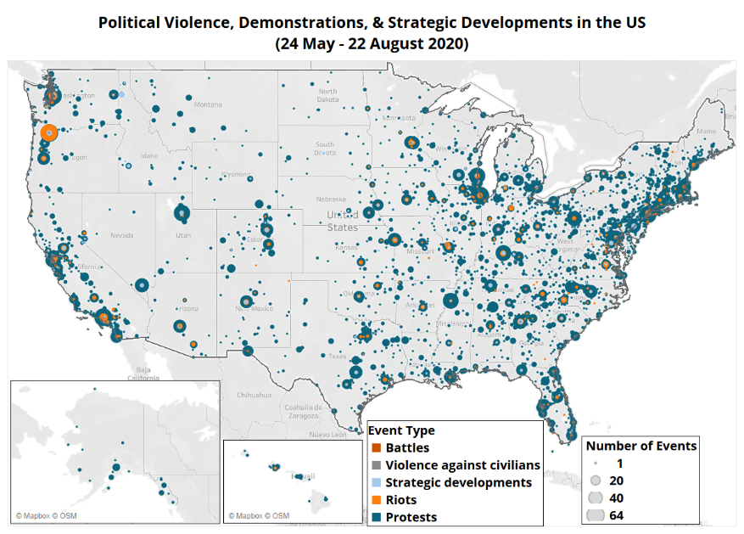
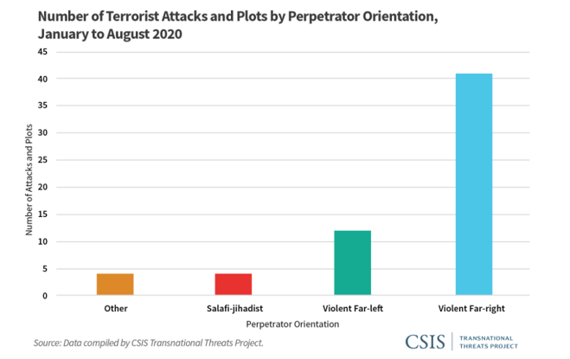
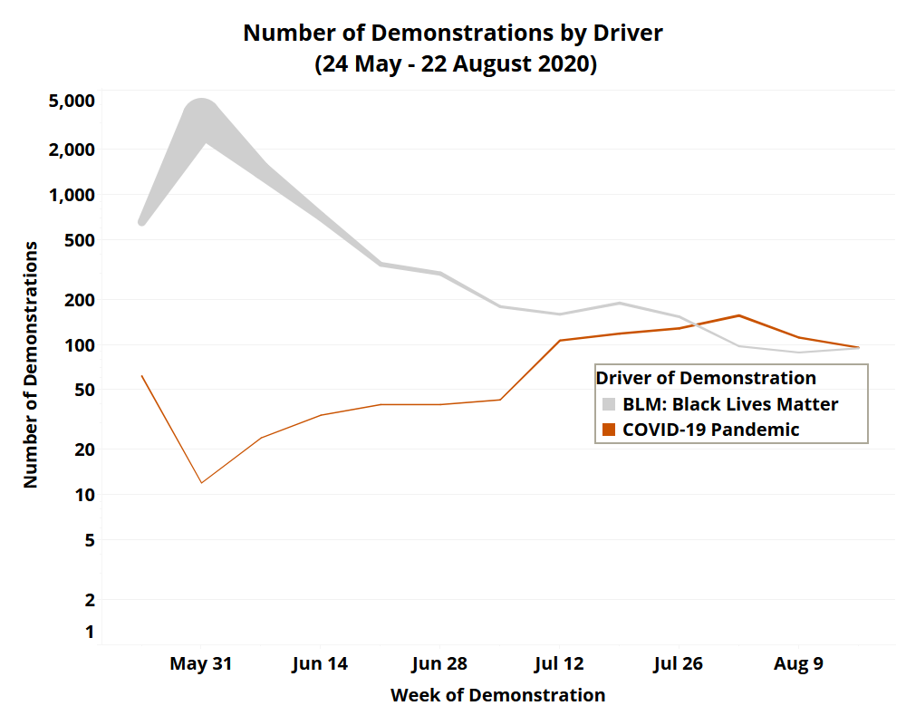
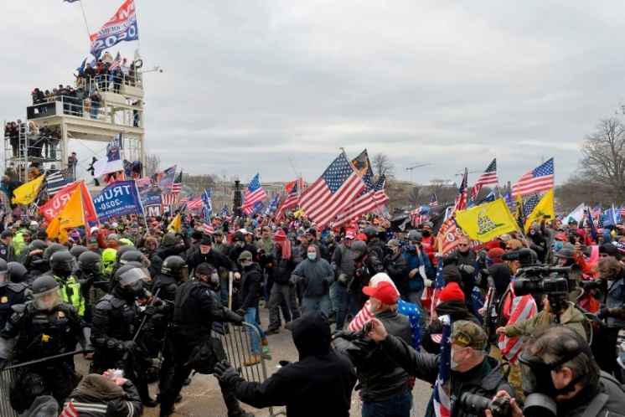
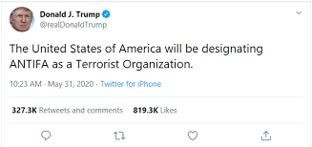
Protest, RIOT OR SEDITIOUS CONSPIRACY OF INSURRECTION?
January 6: 570 arrests of alleged participants, with 170 assault charges
Scant evidence that the Capitol assault was the result of an organized plot to overturn the presidential election result, according to four current and former law enforcement officials.
FBI at this point believes the violence was not centrally coordinated by far right groups or supporters of President Trump
Stop the Steal, Proud Boys, Oath Keepers plans to break in but not coordinated effort to prevent or overturn election certification
Summer 2020
BLM: a movement against police violence and racism, with more than 40 chapters in four countries.
Antifa (anti-fascist): a loose collection of individuals and groups who oppose far right-wing movements, but lack any clear leadership structure
Trump AG Barr described violence being "instigated and carried out by antifa" as "domestic terrorism.“
Internal DHS assessment of mostly opportunist political violence, not coordinated outside attacks
https://www.newsweek.com/antifa-george-floyd-protests-minneapolis-1509219
https://www.csis.org/analysis/war-comes-home-evolution-domestic-terrorism-united-states
https://www.adl.org/resources/reports/adl-debunk-disinformation-and-the-blm-protests
https://acleddata.com/2020/09/03/demonstrations-political-violence-in-america-new-data-for-summer-2020/
https://www.reuters.com/world/us/exclusive-fbi-finds-scant-evidence-us-capitol-attack-was-coordinated-sources-2021-08-20/
https://www.economist.com/open-future/2018/08/09/black-lives-matter-is-not-a-terrorist-organisation

